Slide 1

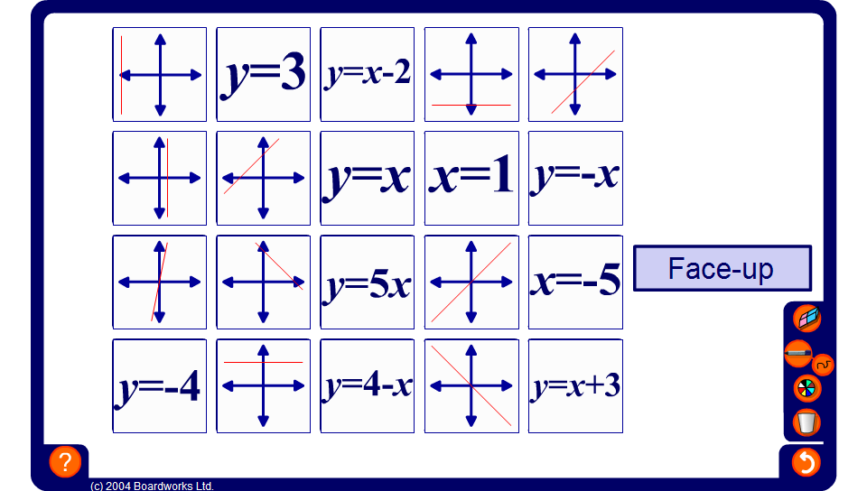


Pairs
Notes:
Pupils take turn to choose two cards with the object of matching an equation to its corresponding graph.
Each time a card showing a graph is revealed discuss possible equations for that graph.
Each time an equation is revealed discuss the properties of the corresponding graph.
The game can be played with the cards face up or face down.

